Slide 1

TECHBOLT KFT
Network Infrastructure Project
Final Exam Presentation
Váradi Levente & Nagy Dániel • Apáczai Csere János Szakgimnázium• Dombóvár • 2024

Slide 2

👥 TEAM MEMBER INTRODUCTION
Váradi Levente
Nagy Dániel
Role:
Role:
Project Manager • Infrastructure Specialist • Network Architect
Project Manager • Tester
Tasks:
Tasks:
✔ Router configuration ✔ OSPF configuration ✔ Firewall & ACL rules ✔ Scrum coordination
✔ VLAN configuration ✔ Documentation writing ✔ Testing plan ✔ Sprint planning

Slide 3

🏢 TECHBOLT KFT – THE CHOSEN COMPANY
📍 Headquarters
Budapest
👥 Employees
60+ staff
🏭 Departments
7 different departments
💻 Activity
IT consulting, electronics
🕐 Service
24/7 customer support
💡 Real market need + 7 departments = a complex yet educational project

Slide 4
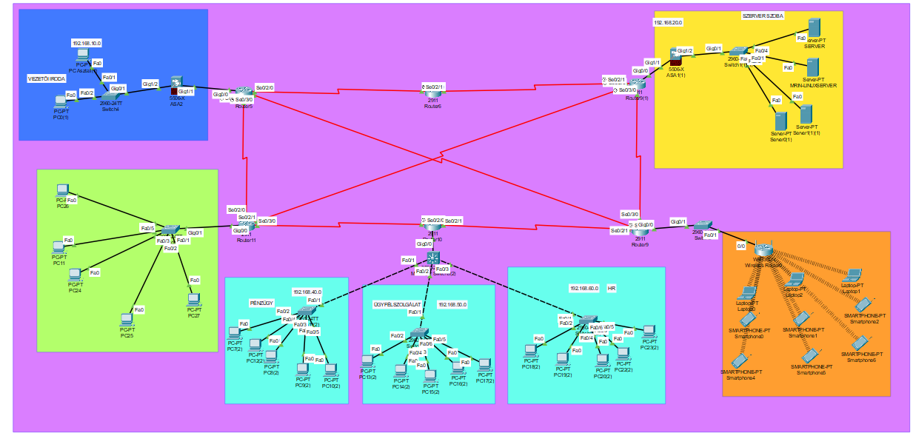
🔧 PACKET TRACER – NETWORK TOPOLOGY
🔴 CORE layer
6x Cisco 2911 routers
🟡 DISTRIBUTION layer
7x Cisco 2960-24TT switches
🟢 ACCESS layer
60+ end devices (PCs, servers, printers)
7 DEPARTMENTS:
Management Office • HR • Finance • Customer Support
Office • Warehouse • Server Room
Packet Tacer topológia screenshot

Slide 5


🛡️ SECURITY PROTOCOLS
FIREWALL – Cisco ASA 5506-X
VPN – Virtual Private Network
What it does:
What it does:
Filtering inbound and outbound traffic, blocking malicious content
Biztonságos távoli kapcsolat a vállalati hálózathoz
How:
Types:
Stateful inspection – tracks every connection
Site-to-site VPN (branch offices)
SSL VPN (remote workers)
Config:
Encryption:
DMZ zone • NAT • Port forwarding
IPSec protocol • AES-256

Slide 6
🌐 NETWORK PROTOCOLS
🔀 OSPF
🔲 VLAN
Open Shortest Path First
Virtual LAN
Dynamic routing – automatically finds the shortest path. If a link goes down, a new route is found instantly!
Network segmentation – 1 physical network split into multiple virtual segments. Security ↑ • Performance ↑
📡 DHCP
🔒 ACL
Dynamic Host Config Protocol
Access Control List
Automatic IP assignment – the server assigns the IP, subnet mask, gateway, and DNS.
Access rules – who can access what. E.g., HR can only access payroll!

Slide 7
⚡ SCRUM METHODOLOGY
8
📋 Sprint Planning
Planning weekly tasks
Total sprints
💬 Daily Stand-up
1
Daily 15-minute sync on Discord
Weekly sprints
✅ Sprint Review
Presenting weekly results
15'
🔄 Retrospective
Daily stand-up
What did we do well? What should we improve?

Slide 8
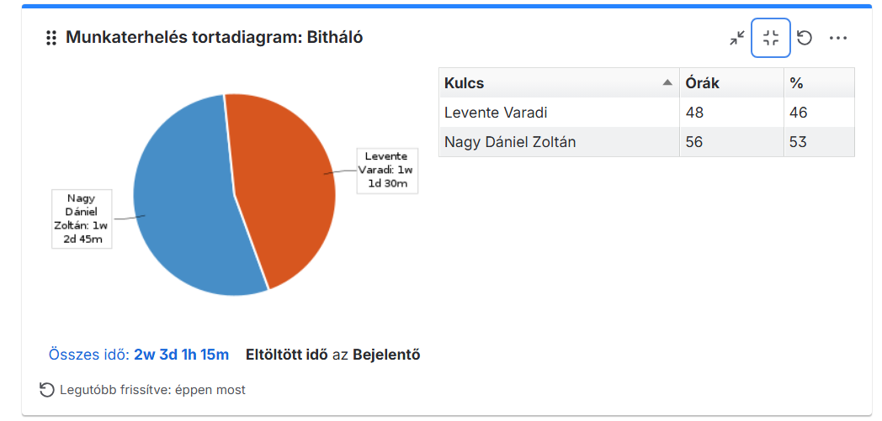
📋 JIRA – PROJECT MANAGEMENT
TO DO
IN PROGRESS
TESTING
DONE ✅
Task 1
Task 1
Task 1
✓ Task
Task 2
Task 2
Task 2
✓ Task
Task 3
Task 3
Task 3
✓ Task

Slide 9

🐙 GIT & GITHUB – VERSION CONTROL
🌿 Branch strategy
Main + feature branches
💬 Commit convention
Semantic commit messages
🔁 Pull Request
Code review before every merge
📦 Stored content:
.pkt files • Configurations • Documentation • Tests • Presentation

Slide 10
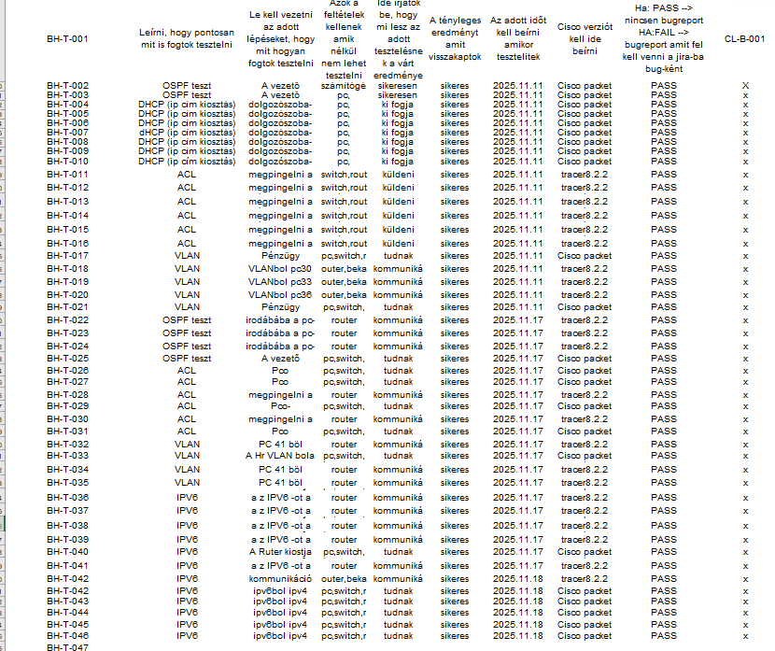
🧪 TESTING PROCESS
🔹 Unit test
54
Individual device functionality
🔸 Integration test
test cases
Inter-department communication
100% ✅
🔶 System test
Full network operation
🛡️ Security test
ACL rules, firewall

Slide 11
📊 PROJECT STATISTICS
⏱️ Time distribution
🖥️ Device distribution
40% Implementation
75%
12%
30% Planning
PCs – 45 units
Switches – 7 units
20% Testing
7%
5%
10% Documentation
Routers – 6 units
Servers – 3 units

Slide 12
PROJECT SUMMARY
🌐 Modern network
⚡ Agile methodology
Cisco devices, 3-tier architecture
8 sprints, Scrum + Jira + GitHub
✅ 100% testing
📄 Documentation
54 test cases, full coverage
Detailed technical documentation
🙏 Thank you for your attention!
Váradi Levente & Nagy Dániel • Apáczai Csere János Vocational School • 2026

